Slide 1

Name : Muhammad Ammar Jan Roll No: 435 Section : G

Slide 2

Interpolation And Its Applications

Slide 3
What Is Interpolation:
Interpolation is a method of fitting the data points to represent the value of a function.
This helps to determine the data points in between the given data ones. This method is always needed to compute the value of a function for an intermediate value of the independent function.
It is mostly used to predict the unknown values for any geographical related data points such as noise level, rainfall, elevation, and so on.

Slide 4
Application Of Interpolation:
Zooming Digital Images.
Missing AIS Data of Ship (automatic identification system).
Heat Transfer Estimation.
Image Processing.

Slide 5
:Missing AIS Data of Ship
The Interpolation Method for the missing AIS(automatic identification system) Data of Ship . The interpolation method is proposed to recover missing AIS data based on the AIS data which was received before and after the missing time interval .
AIS type, the second one consists of the ship position, UTC time, course over ground (COG), speed over ground (SOG), heading angle (HDG), rate of turning (ROT), the heeling angles. In this research, the dynamic information such as the ship position, COG, SOG and HDG are considered for interpolating the problem of missing AIS data.

Slide 6
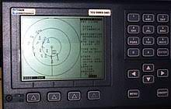

Slide 7
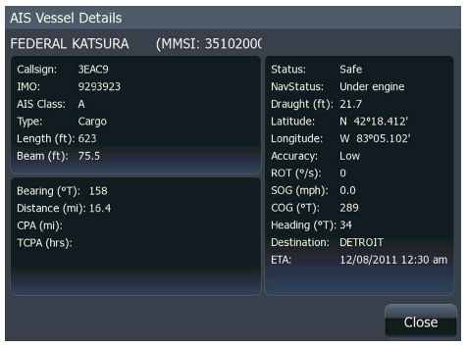

Slide 8
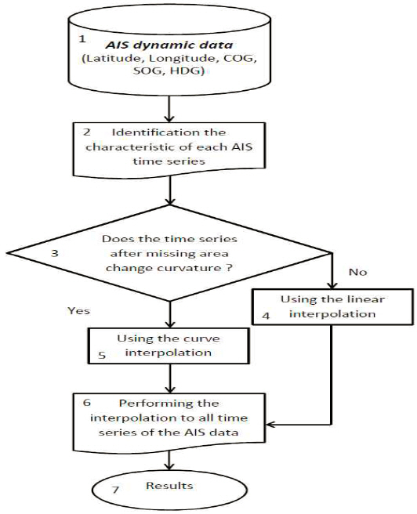
Algorithm of interpolation method:

Slide 9

Linear interpolation
In mathematics, linear interpolation is a method of curve fitting using linear polynomials to construct new data points within the range of a discrete set of known data points.
Solving this equation for y, which is the unknown value at x, gives
Piecewise Linear Interpolation

Slide 10


Piecewise Linear Interpolation
Piecewise linear interpolation is adopted in recovering the missing points of the AIS time series.
Piecewise Linear Interpolation

Slide 11


Piecewise Cubic Hermite Interpolating
In order to preserve the shape of the data, this interpolation method is proposed, it is good for interpolating the time series which has characteristics of the curved shape
Piecewise Linear Interpolation

Slide 12





Slide 13





Slide 14
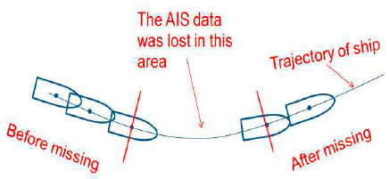
Numerical method for interpolation missing AIS data of ship

Slide 15
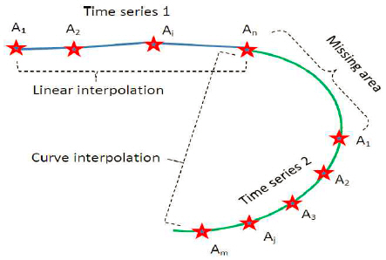
Numerical experiment and results comparison

Slide 16
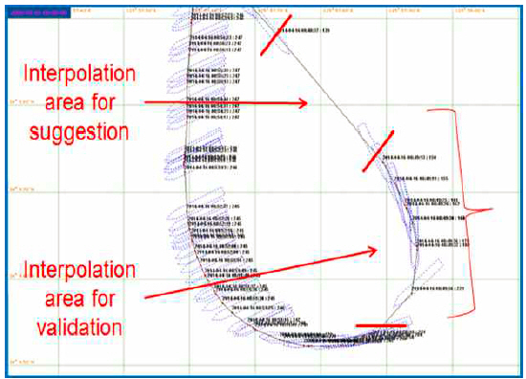
Numerical experiment and results comparison

Slide 17
Conclusion For AIS Project:
- This research proposes one method for interpolating the missing AIS data of ships based on numerical interpolation and the characteristics of the AIS time series.
- All parameters such as the ship position, course over ground, speed over ground and the heading angle are interpolated sufficiently by this method.
- This method includes linear interpolation, cubic Hermit interpolation and an identification mechanism, so it has an adaptive ability to many shape AIS data.
- Experiments show that the results of this method are better than in the previous method in interpolating the AIS data problem.
- In the future, the dynamic characteristics of the ship according to the kinematic equation and the disturbance of current and wind will also be considered to improve the ability to predict the missing area which has wide time range.

Slide 18
:Disadvantages of Interpolation:
Cannot estimate above maximum or below minimum values.
Not very good for peaks or mountainous areas..
Linear interpolation is quick and easy, but it is not very precise.

Slide 19
:Reference:
https://www.glonav.org/journal/view.php?number=50
https://developer.apple.com/documentation/accelerate/use_linear_interpolation_to_construct_new_data_points
https://www.slideshare.net/mdtanvirhossain7/application-of-interpolation-in-cse#:~:text=In%20the%20mathematical%20field%20of,set%20of%20known%20data%20points.
https://en.wikipedia.org/wiki/Linear_interpolation#:~:text=In%20mathematics%2C%20linear%20interpolation%20is,set%20of%20known%20data%20points.

Slide 20
Thank You

